Slide 1
Martha del Angel
Tecnologico de Monterrey, México
Lifelong Learning & Research, Glasgow, Scotland
May 14, 2012
“A Center for Adult learning in a university setting. Where are we?”

Slide 2
Justification
The demographic profile of the Mexican society has changed over the last 30 years considering birth and aging.
The growth of the population was 3.4, in 1960 but it decreased up to 1.8 in 2012.
The life expectancy notably increased: In 1990 it used to be 70.6 years and in 2010 it reached 75.6 years of age.
The aging of the population has become not only a demographic challenge but also a social one because it has an impact on the security systems, sanitary assistance and day care.
Life expectancy should go along with actions and programs that promote the quality of life by making senior citizens participate in our society.

Slide 3
Mexico: population over 60 years of age (1950-2010)
Year | Population of 60 years of age or more | Percentage over total population | Total
1950 | 1 939 745 | 5.55 | 34 923 129
1990 | 4 988 158 | 6.13 | 81 249 645
2010 | 10 955 379 | 8.95 | 112 336 538
Source: INEGI, Census, 2010.

Slide 4
Justification
Senior citizens who have retired require options to keep a social interaction so that they feel productive and increases their self-esteem and independency (Programa de atención al adulto mayor, Consejo de Desarrollo Social: 29).
According to the 2010 Population Census, in the State of Nuevo Leon (where Monterrey is part of), 7% of the population (270 000 inhabitants) were 60 years of age. This tendency suggests that by 2030 senior citizens will reach 18% percent of the population of state which is aproximately one million people.
This same census revealed that 3.3.% (3,873 people) had professional studies, and a 0.7% (389 people) had graduate studies.

Slide 5
Justification
Those people who have professional studies might be intterested to continue their personal and professional life in a general way. This fact leads to the proposal of a Center for adult learning in Tecnologico de Monterrey, Monterrey, Campus.
The interest in senior citizens has increased. Some educational institutions from Monterrey have developed proposals and programs for this group; such is the case of public and private universities that offer programs focused on diploma courses and some health activities.
This proposal is an integrated program because it includes updating academic activities, human development programs, health and social participation.

Slide 6
Proposal
The Center for adult learning is a place that gives adults and senior citizens who have some professional background the opportunity of an integral development.
It will offer training prgrams, intelectual development, artistic and cultural activities, memory recovery, nutrition, and physical activities.
Professors from Tecnologico de Monterrey will be involved in this program as well as some other areas of the institute that are engaged in the community´s well being.

Slide 7
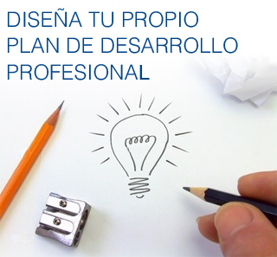

Objectives
1. | To develop programs that enhance the integral development of senior citizens towards their social interaction.
2. | To recover the life experience of senior citizens in a documental or digital form to help them go back to public and private life and rescue their memory and identity in the community.
3. | To start consulting activities as a way of contributing to the social and professional development for new generations.
4. | To develop a web page for the Center and links with institutions related to these program.
5. | To establish social networks in facebook to motivate communication among participants of the Center.
 |  | 7

Slide 8
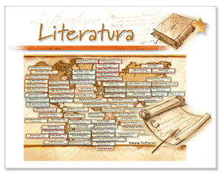
Programs
Diploma courses and seminars
To develop relevant contents in the area of humanities and social sciences. It is flexible and
organized by modules that can be taken independently. Some areas and topics are the following:
a) Humanities
• To understand Today´s world (post.modernism).
• Ethics and the person in today´s society.
• Philosophy for life.
• Psychology of the family (Family, values and society).
•Development of critical thinking throughout life.
• Literature and society in Latin America.
• Literature and society in México.
• Art and culture.
• Films, literature and culture.
• Films, music and literature
8

Slide 9

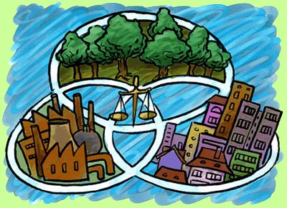
Programs
b) Social Sciences
• History of the XX Century
• History of contemporary México (1920-2011).
• North east México and the border with the United States
• Mexican politics and its repercussions in social life
• Society and sustainable development.
• Communication and Media in its impact on contemporary society.
• A global world: economy, politics, technology in everyday life.
• Changes in the world policies:Europe, the United States and Asia.
9

Slide 10

Programs
2. Technical courses to develop or improve technical skills and languages.
• Foreign Languages
• Computer
• Ebooks
• Social networks
3. Nutrition and well being To design courses related to exercising and nutrition. This program will be carried on along with Tecnologico de Monterrey School of Medicine and the Medical center Zambrano Helión
• Nutrition
• Yoga
• Tai Chi
• Social walking
10

Slide 11
Programs
4. Reading circles
To organize groups of readers to analyze, discuss and enjoy classic literature for critical thinking skills and cultural enrichment.
Society (Citizenship and volunteering)
To establish actions and agreements with institutions and civil
organizations to participate in civic activities and support for
the community. Adopted grandparents: literature in elementary
schools, hospitals or museums.
11

Slide 12
6. Memory recovery and individual and collective identity
To organize collective and individual activities to record, discuss, share and write about life experiences. Some topics are:
Personal or group stories.
Stories of regional identity
Cultural experiences (spiritual, artistic, etc).
The Nature ‘s friends Club
To visit local places of natural wonders and become involved with
civil organizations that promote the protection of the environment
and sustainable development.
.
12

Slide 13
“Friends of the culture Circle”
To visit museums and historical sites to know the cultural richness of the
country.
7. Center for consulting and counseling for young professionals
To support the development of young professionals to start new companies.
The Film Club
To watch movies to analze and discuss the content towards reflexion and critical
thinking over modern or historical topics of their interest .
Electronic magazine: “Vida Plena”
To produce an electronic magazine with information, notes, relevant analysis for
senior citizens.
13

