Slide 1
Public engagement and lifelong learning: old wine in a new bottle, or a blended malt?
Paul Manners
Director, National Co-ordinating Centre for Public Engagement
Notes:
Our focus today is solutions... And alter there will be five workshops for you to choose from where practical, positive steps are being taken to embed public engagement.
Firs, a bit of background to the two projects which have generated these workshops – the beacons for PE and the Search project. Shortly, you’ll hear from both Gillian and Julie – but first just a bit of scene setting from me

Slide 2



Slide 3
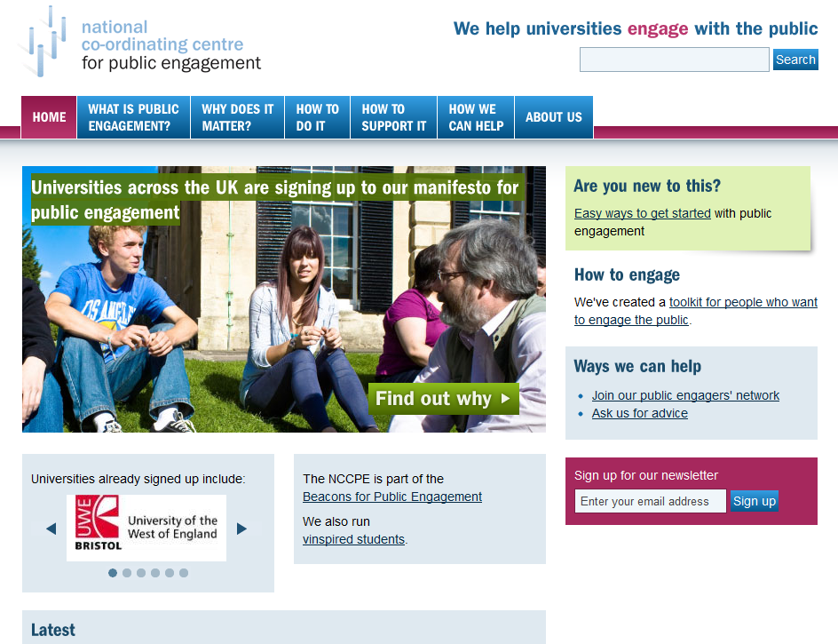

Slide 4

Notes:
We’re aiming to be very positive today – but to offer solutions you need to know what the problems are you’re trying to solve and this is a good place to start – I’m sure all or nearly all of your are aware of this hugely influential report which identified a whole host of issues ... In particular the research-driven culture – including pressure to publish, attract funding for and build careers on ‘hard research’ – means that public engagement is not a priority within many HEIs. Public engagement is also seen as not well regarded by peers, and is difficult to undertake as it does not bring in significant funding.

Slide 5

This initiative aims to create a culture within UK Higher Education where public engagement is formalised and embedded as a valued and recognised activity for staff at all levels, and for students.
Funded by the UK Funding Councils, Research Councils UK and the Wellcome Trust

Slide 6
Defining the territory: universities and engagement
Public engagement
The general public
Communities of place & interest
Schools and colleges
Community organisations
Potential stakeholders or partners
Regional / national govt
Civic
engagement
Voluntary orgs and charities
Community engagement
Local authorities
NGOs
Regional strategic bodies
Social enterprises
Enterprise agencies
Businesses
Business engagement

Slide 7
PUBLIC ENGAGEMENT WITH RESEARCH
Actively involving the public in the research activity of the institution
Collaborative research projects
Co-produced research with the public helping to shape the research design and/or delivery
Supporting the development of community-based researchers
Seeking insight or advice to inform future activity
ENGAGED TEACHING
Developing teaching activities which positively impact on the community, and enhance students’ engagement skills
Supporting lifelong learning and community capacity building
Teaching engagement skills
Raising aspirations of young people
Service (or ‘community-based’) learning
The engaged university
KNOWLEDGE EXCHANGE & SHARING
Increasing the two-way flow of knowledge and insight between the university and wider society
Communicating research activity and outcomes
Contributing to regional and national policy development
Offering consultancy and CPD for community organisations
SOCIAL RESPONSIBILITY
Seeking to maximise the benefits that the institution can generate for the public
Opening up facilities and campus to the public
Investing in partnerships and infrastructure to support collaboration with civic society
Staff and student volunteering to support the community

Slide 8
Student volunteering / service learning
Work-based learning
Education
Lifelong learning / continuing education
Public engagement
Civic / personal development
Research / science communication
Brokerage / KE
Participatory research / user involvement
Community development

Slide 9

What is public engagement?
Public engagement describes the myriad of ways in which the activity and benefits of higher education and research can be shared with the public.
Engagement is by definition a two-way process, involving interaction and listening, with the goal of generating mutual benefit.

Slide 10
Focal points for embedding public engagement
PURPOSE
Embedding a commitment to public engagement in institutional mission and strategy, and championing that commitment at all levels
PROCESS
Investing in systems and processes that facilitate involvement, maximise impact and help to ensure quality and value for money
PEOPLE
Involving staff, students and representatives of the public and using their energy, expertise and feedback to shape the strategy and its delivery

Slide 11

We believe that universities and research institutes have a major responsibility to contribute to society through their public engagement, and that they have much to gain in return.
We are committed to sharing our knowledge, resources and skills with the public, and to listening to and learning from the expertise and insight of the different communities with which we engage.
We are committed to developing our approach to managing, supporting and delivering public engagement for the benefit of staff, students and the public, and to sharing what we learn about effective practice.

Slide 12
What next?

Slide 17
Focal points for embedding public engagement
PURPOSE
Embedding a commitment to public engagement in institutional mission and strategy, and championing that commitment at all levels
PEOPLE
Involving staff, students and representatives of the public and using their energy, expertise and feedback to shape the strategy and its delivery
PROCESS
Investing in systems and processes that facilitate involvement, maximise impact and help to ensure quality and value for money
MISSION | Create a shared understanding of the purpose, value, meaning and role of public engagement to staff and students and embed this in your strategy and mission.
LEADERSHIP | Support champions across the organisation who embrace public engagement
COMMUNICATION | Communicate consistent, clear messages to validate, support and celebrate it, and ensure open and two-way communication with members of the public and community organisations.

Slide 18
Focal points for embedding public engagement
REWARD | Recognise and reward staff involvement within recruitment, promotion, workload plans and performance reviews, and celebrate success with awards or prizes.
SUPPORT | Co-ordinate the delivery of public engagement to maximise efficiency, target support, improve quality, foster innovation, join up thinking and monitor involvement and impact.
LEARNING | Provide opportunities for learning and reflection and provide support for continuing professional development and training
PURPOSE
Embedding a commitment to public engagement in institutional mission and strategy, and championing that commitment at all levels
PROCESS
Investing in systems and processes that facilitate involvement, maximise impact and help to ensure quality and value for money
PEOPLE
Involving staff, students and representatives of the public and using their energy, expertise and feedback to shape the strategy and its delivery

Slide 19
Focal points for embedding public engagement
PURPOSE
Embedding a commitment to public engagement in institutional mission and strategy, and championing that commitment at all levels
PROCESS
Investing in systems and processes that facilitate involvement, maximise impact and help to ensure quality and value for money
PEOPLE
Involving staff, students and representatives of the public and using their energy, expertise and feedback to shape the strategy and its delivery
STAFF | Ensure that all staff – in academic and support roles – have opportunities to get involved in informal and formal ways.
STUDENTS | Proactively include and involve students in shaping the mission and in the delivery of the strategy, and maximise opportunities for their involvement.
PUBLIC | Invest in people, processes and infrastructure to support and nurture the involvement of individuals and organisations external to the HEI

